Slide 1
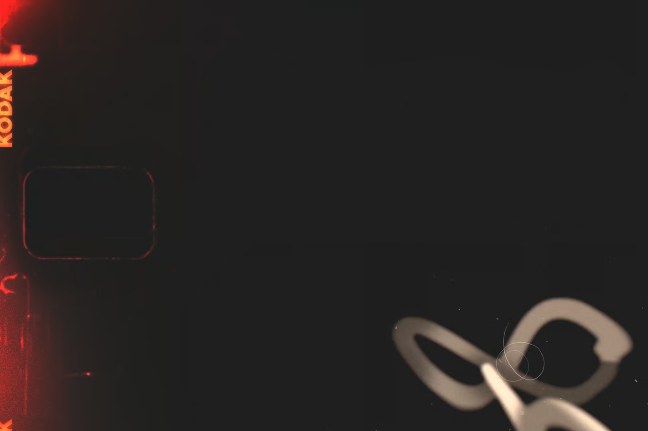
PHYSICS
Interdisciplinary Project
ON
“MOTION IN A PLANE”

Slide 2

Introduction
In everyday life, things rarely move in a simple straight line. Footballs arc through the air, cars curve around street corners, planets revolve elliptically around stars, and so on…
All of the cases mentioned above are examples of motion in a plane.
In today’s presentation, we will:
  Identify how projectile motion is used in entertainment.
  Apply the concepts of projectile motion in sports.
  Identify how circular motion is used to model roads for safe driving.
  Explore the role of circular motion in videography.

Slide 3



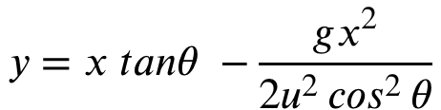
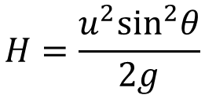
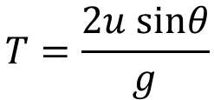
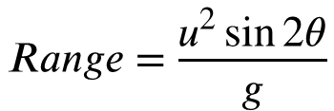
Projectile Motion
In Video Games / Computer Science
Remember Angry Birds? Or perhaps, Super Mario 64? Both of these extensively make use of a projectile motion model to move their characters.
2-D projectile motion happens over both the X and Y axes, but they can be treated independent of each other.
A convenient set of formulae help us model how these characters should move along a 2-D plane, i.e., your screen:
$$y=x tanθ −\frac{gx^{2}}{2u^{2}\cos^{2}{θ}}$$
$$T=\frac{2u sinθ}{g}$$
$$Range=\frac{u^{2}\sin{2θ}}{g}$$
$$H=\frac{u^{2}\sin^{2}θ}{2g}$$

Slide 4
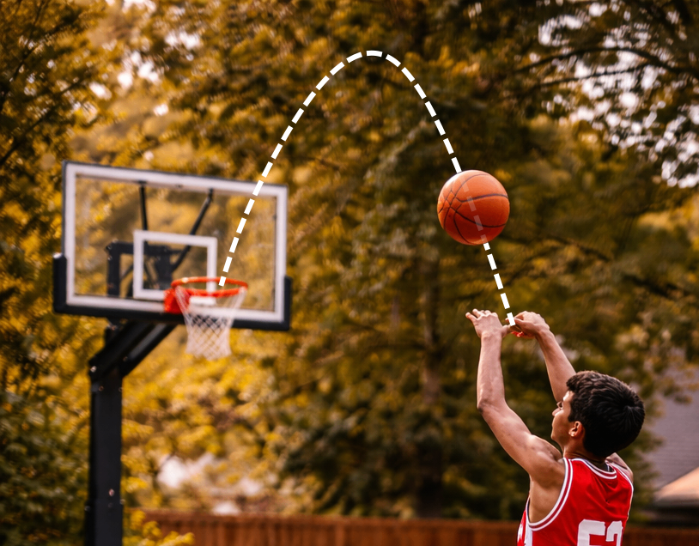
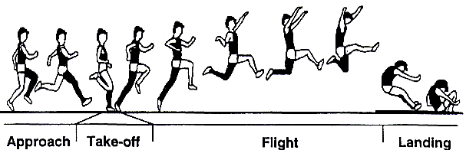
Projectile Motion
In Sports
A basketball player optimizes their ball’s launch angle to get more vertical distance before gravity pulls it back down.
Similarly, long jumpers optimize their launch angle close to 45° to gain maximum horizontal range before they land.

Slide 5
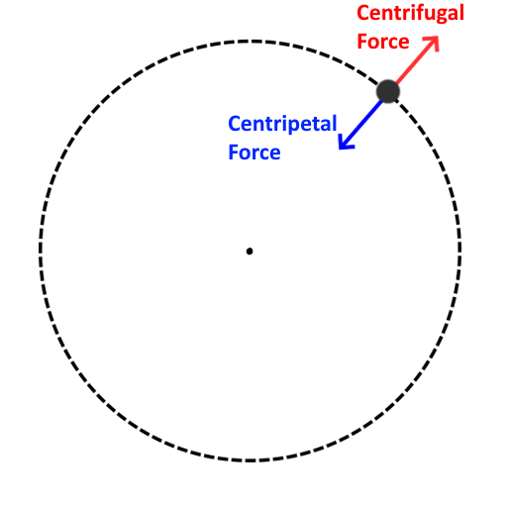
Circular Motion
Circular motion along a 2-dimensional plane is very useful in practical applications.
Specifically, we exploit centripetal and centrifugal forces that arise from circular motion.
The centripetal force is the force acting towards the center of the circular path
E.g. Tension in a string, Friction on a road, etc.
The centrifugal force is the apparent force acting equal and opposite to the centripetal force on the body.

Slide 6
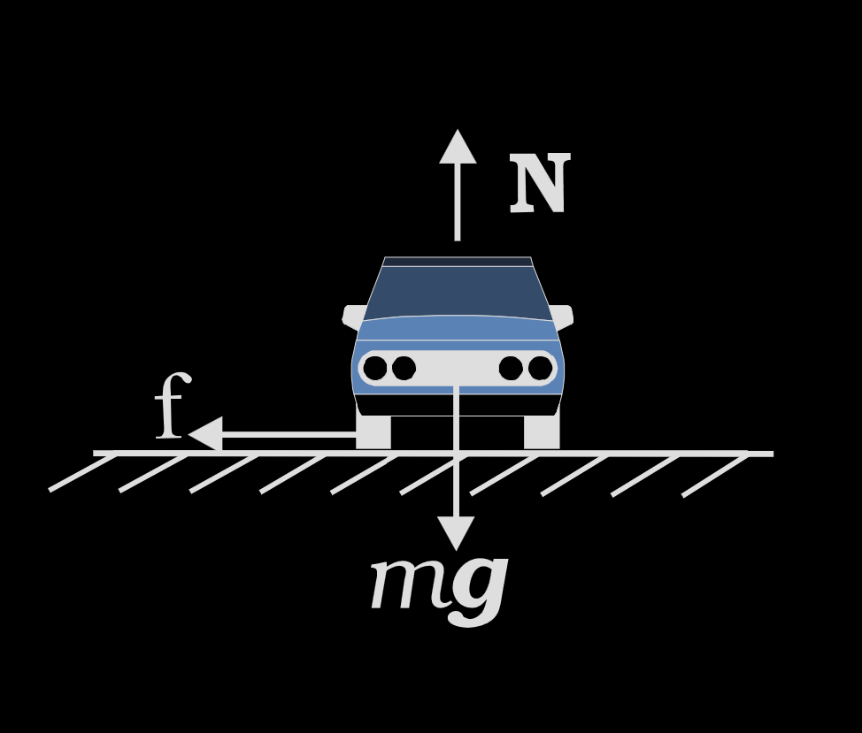
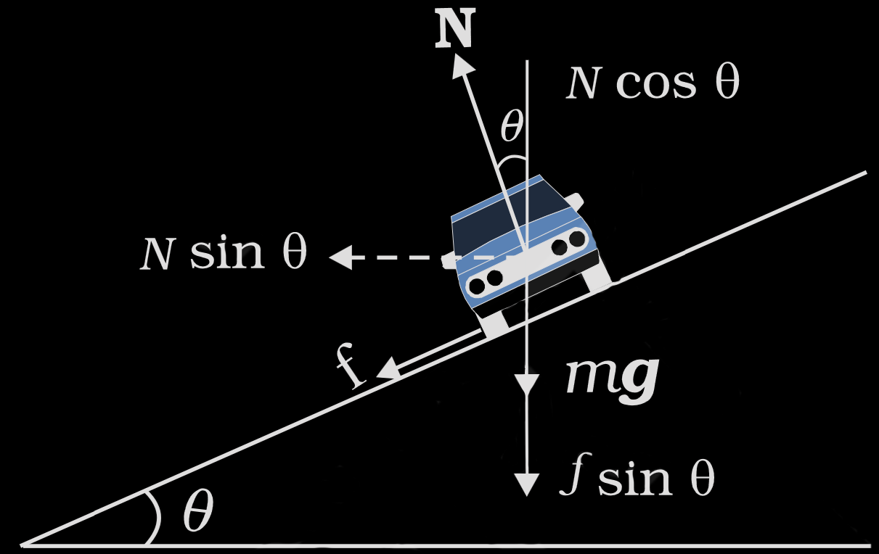
Circular Motion
θ = 0 deg
v = 3 m/s
In Civil Engineering
Unbanked
During turns, the centripetal force keeping the vehicle on the road is supplied only by friction.
Thus, driving on ice or wet roads can inhibit friction and make driving unsafe.
Solution:
Roads are banked (tilted) inwards to use the vehicle’s weight to supply the turning force instead.
Metro tracks are also banked around curved sections for the same reason.
v = 8 m/s
θ = 30 deg
Banked

Slide 7
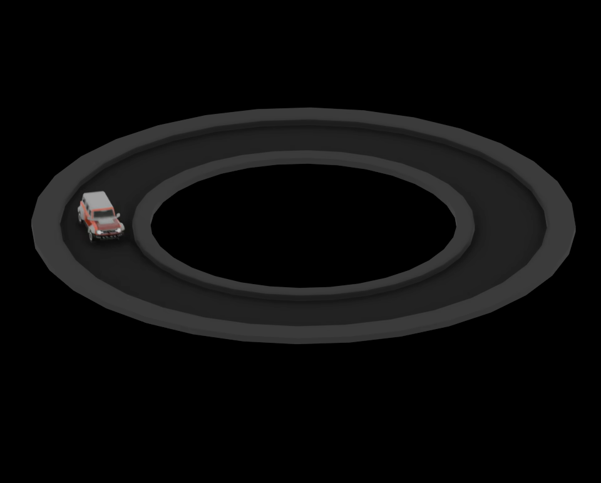
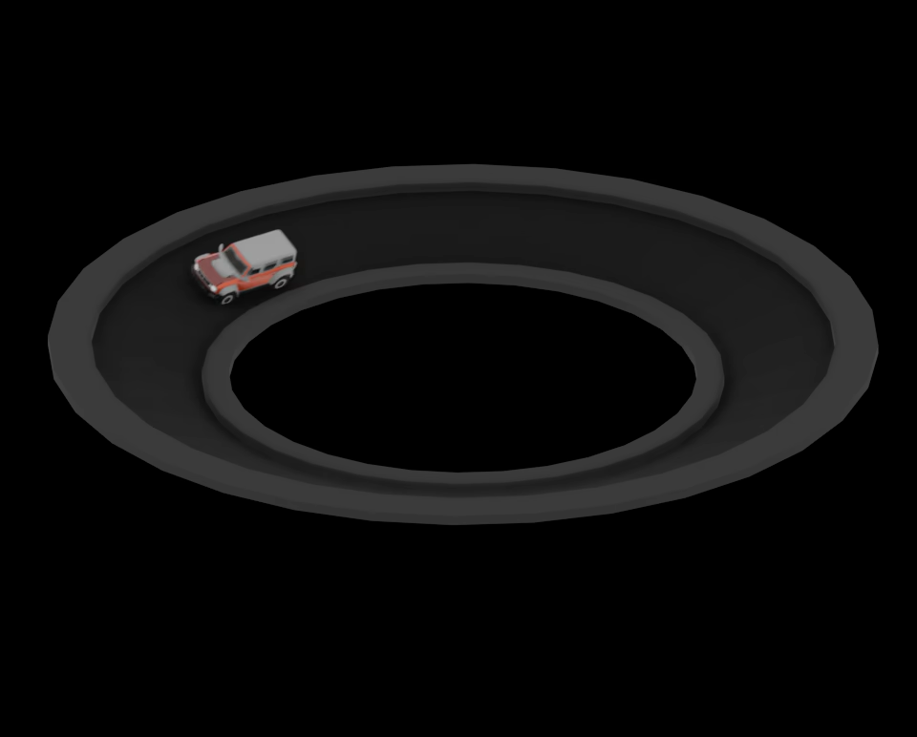
Circular Motion
θ = 0 deg
v = 2 m/s
In Civil Engineering
Unbanked
During turns, the centripetal force keeping the vehicle on the road is supplied only by friction.
Thus, driving on ice or wet roads can inhibit friction and make driving unsafe.
Solution:
Roads are banked (tilted) inwards to use the vehicle’s weight to supply the turning force instead.
Metro tracks are also banked around curved sections for the same reason.
Physics simulation done using Blender
v = 3.5 m/s
θ = 30 deg
Banked
Note how the simulated car is able to travel slightly faster after banking the road

Slide 8
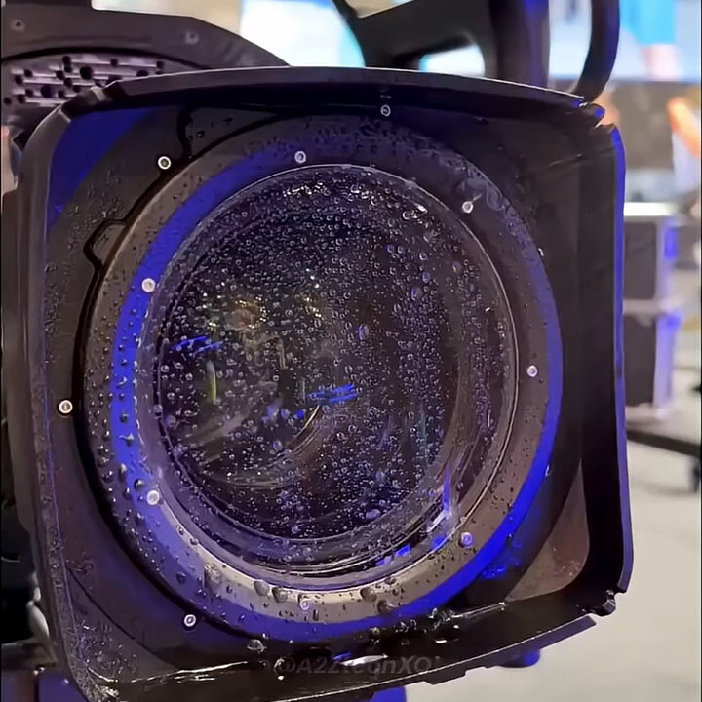
Circular Motion
In Film making
Centrifugal force is exploited in television and film camera lenses.
When shooting in rain, the water collects on the lens surface and obscures the shot.
Solution:
A high-speed rotating glass element is placed at the end of the lens, which collects the rain and pushes it to the edges.
This is because of the centrifugal force acting on the rainwater.

Slide 9
Thank You
Credits
J. Abhinav
Arjun D.
M.G. Ashraf
Karimula Hameed
Kushal
Saravana Kumar
Souhardh K.
Md Rayyan

